Slide 1


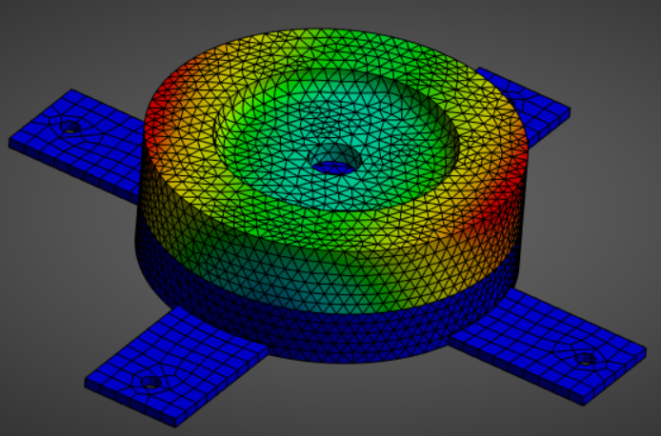
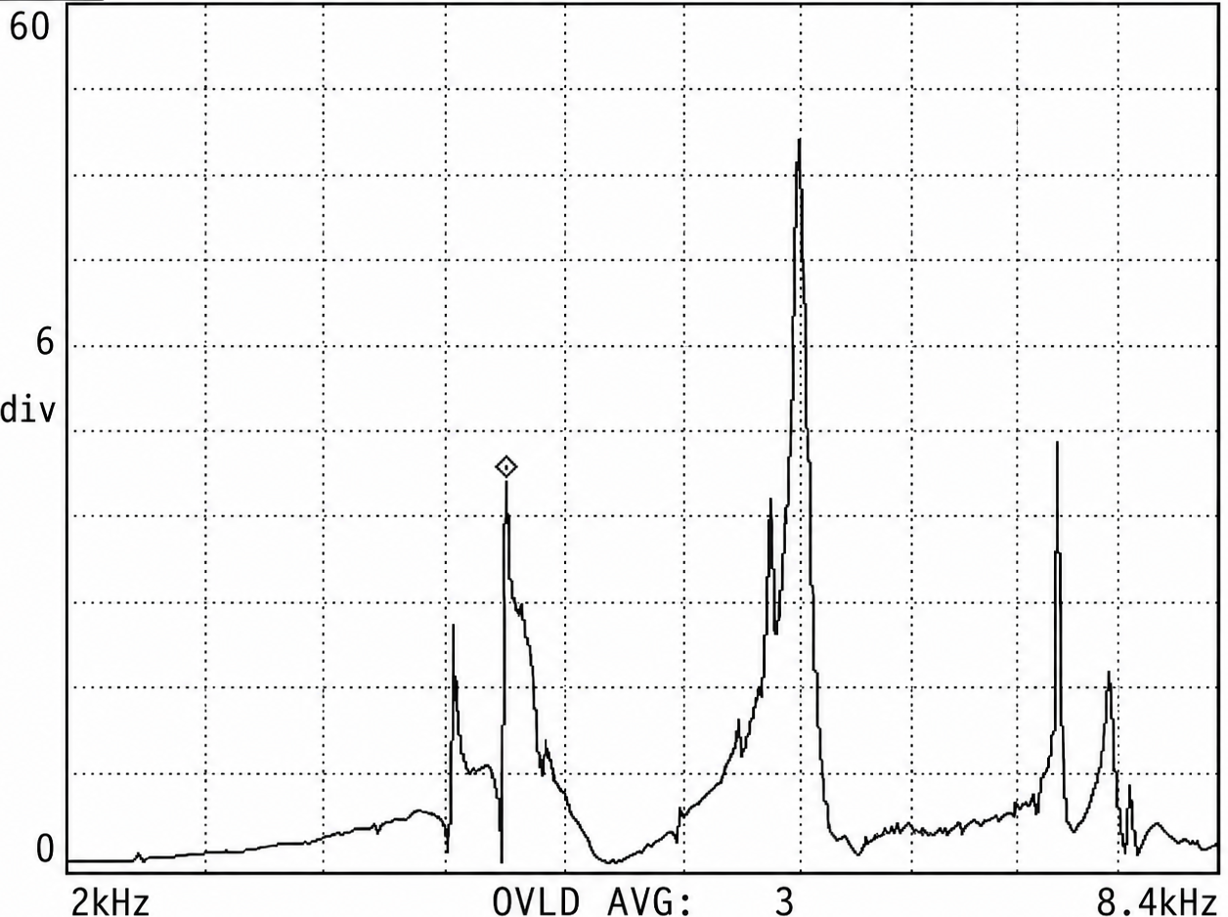
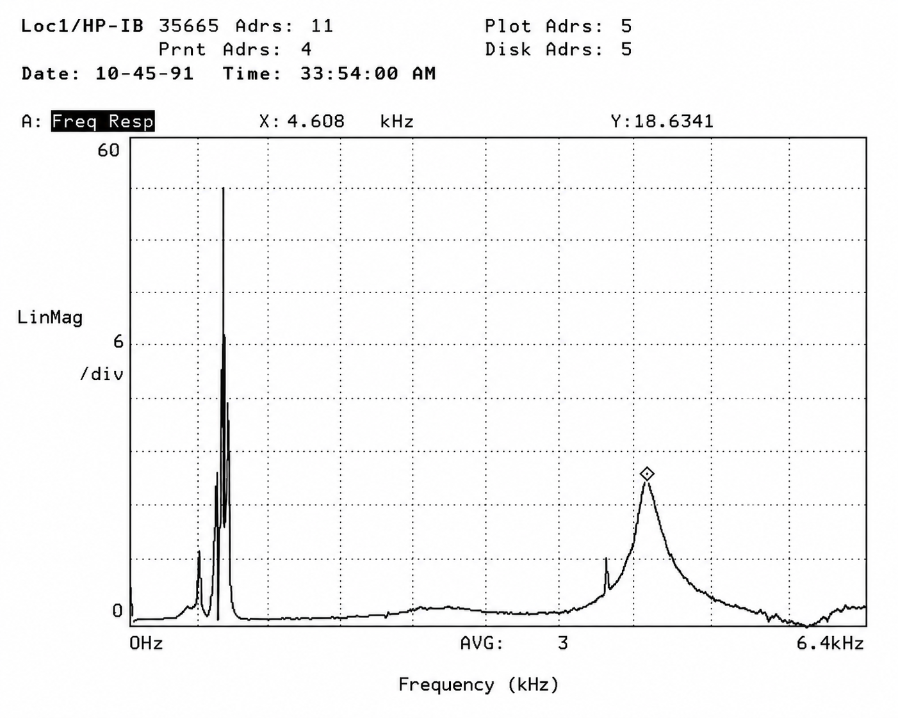
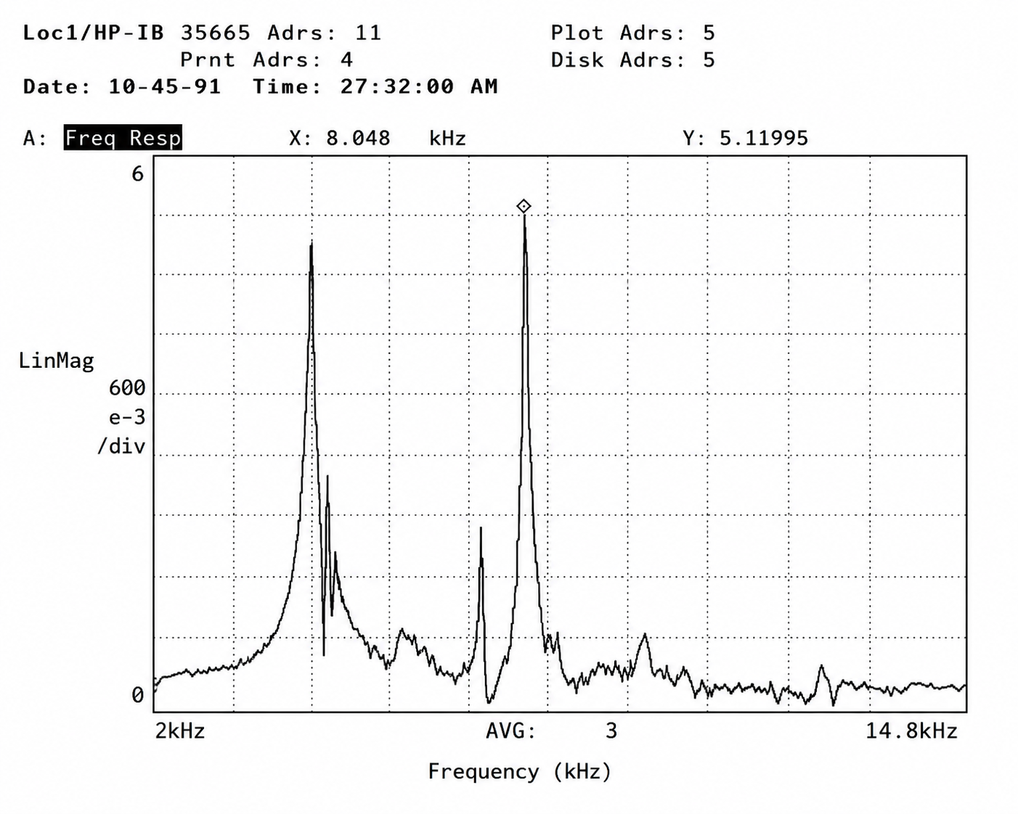
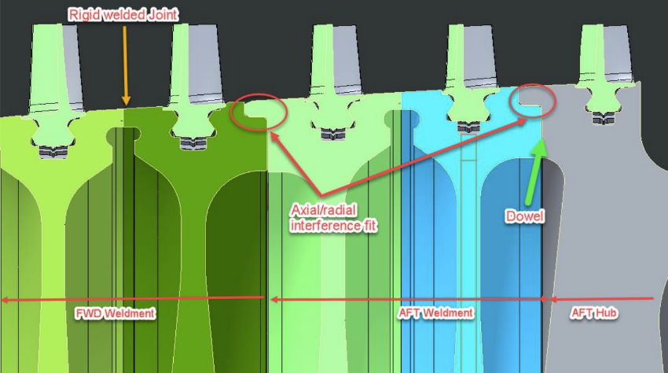
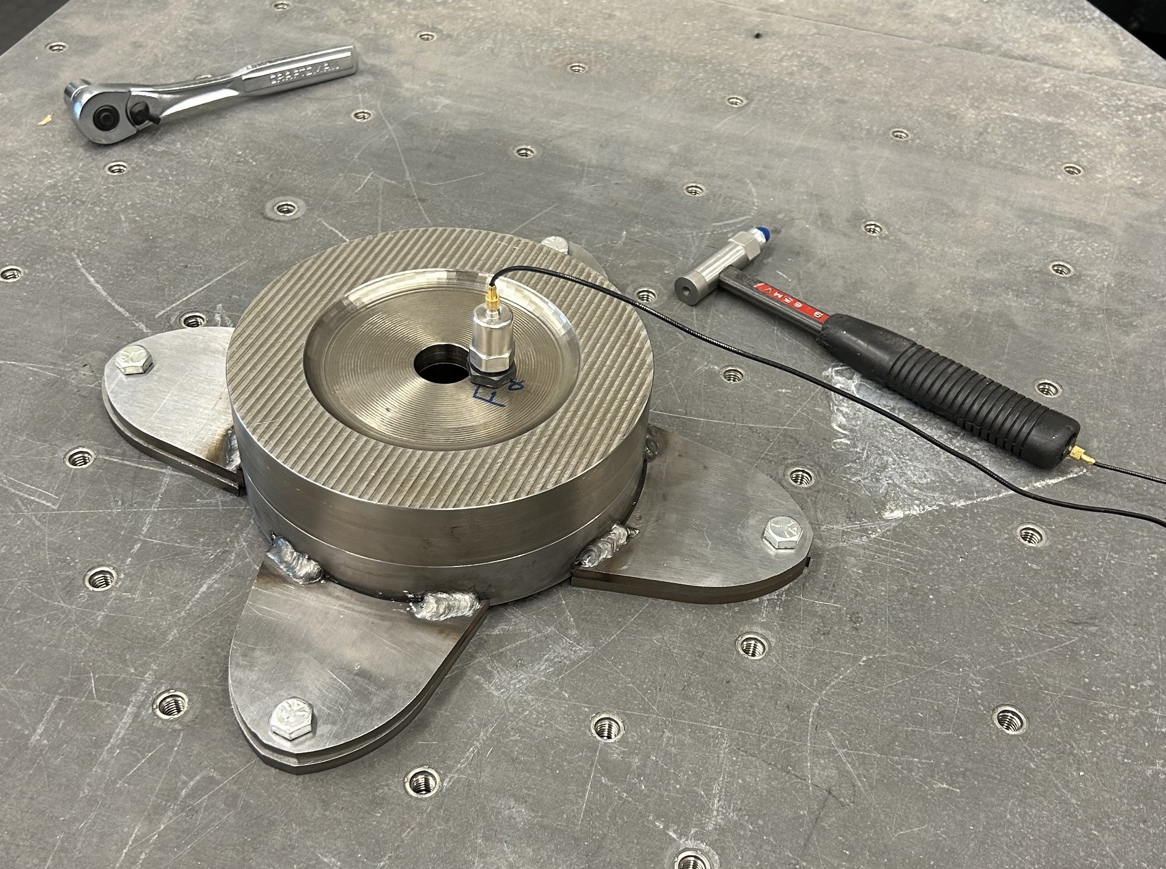
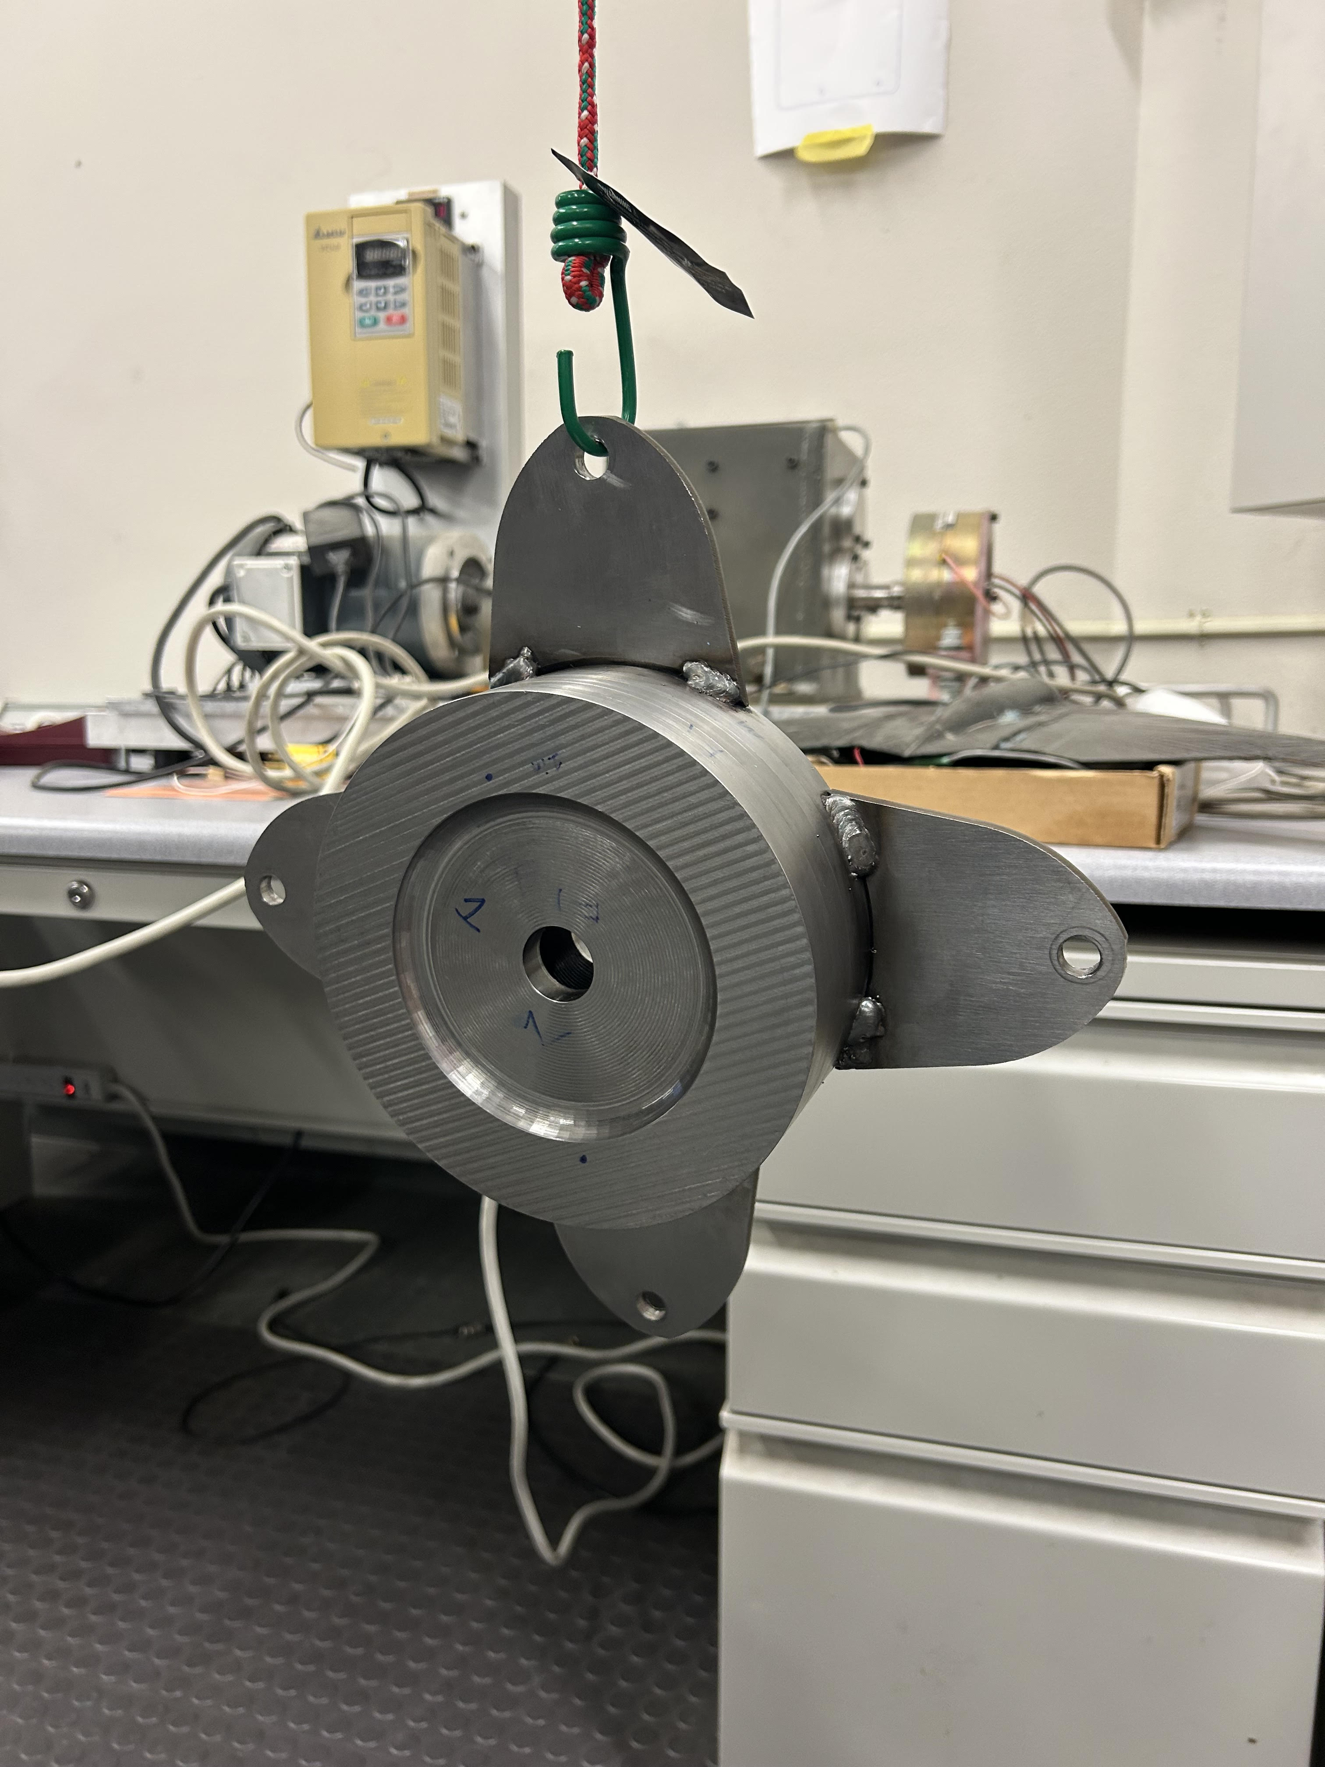
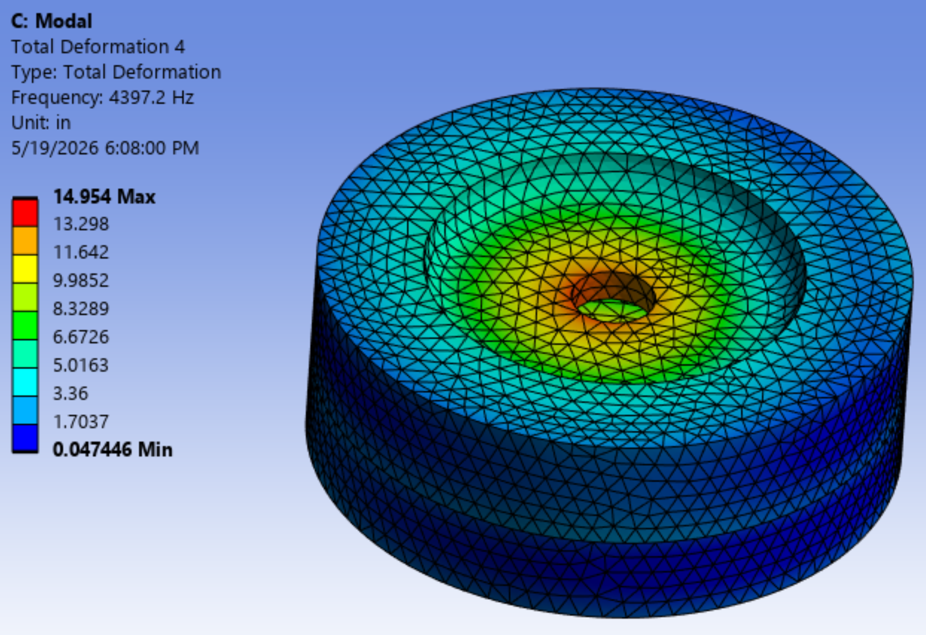
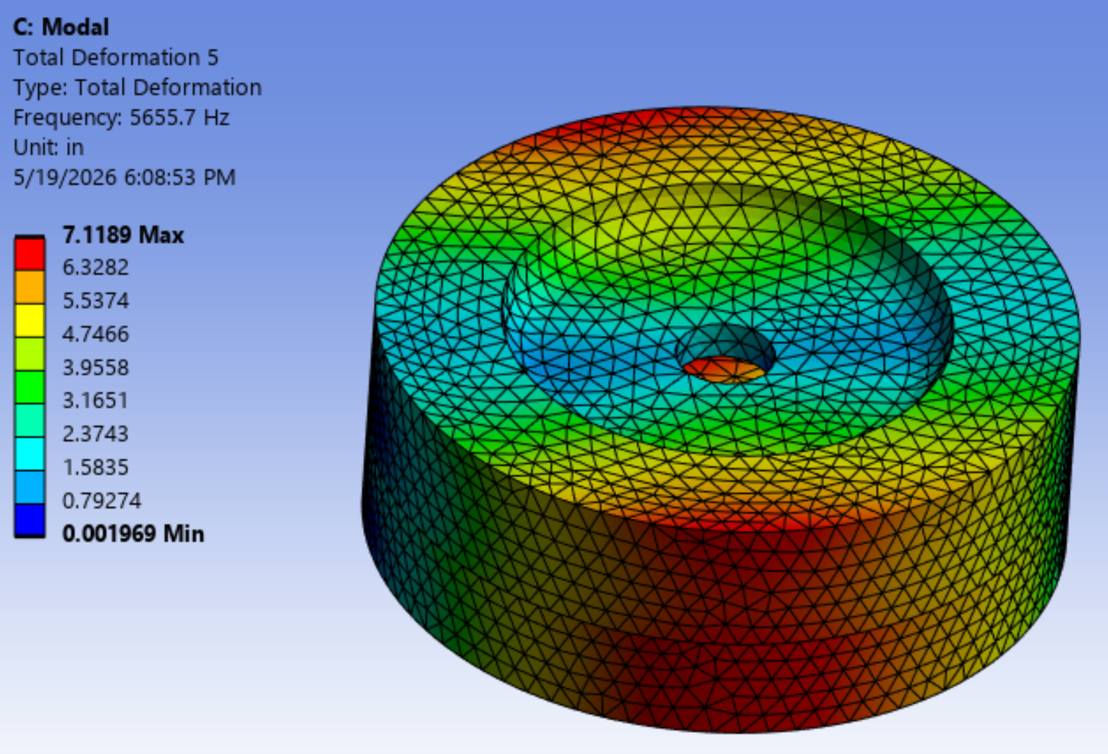
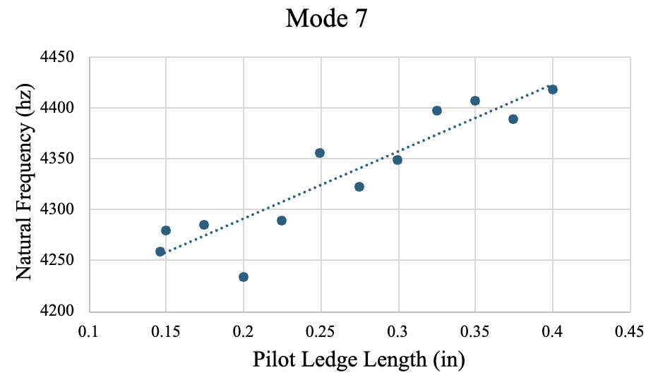
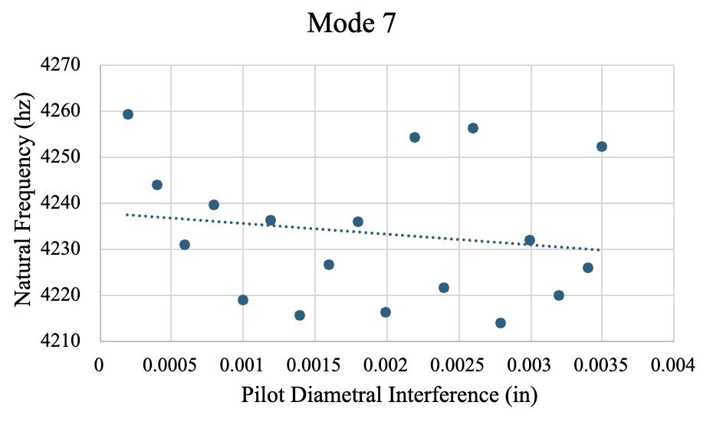
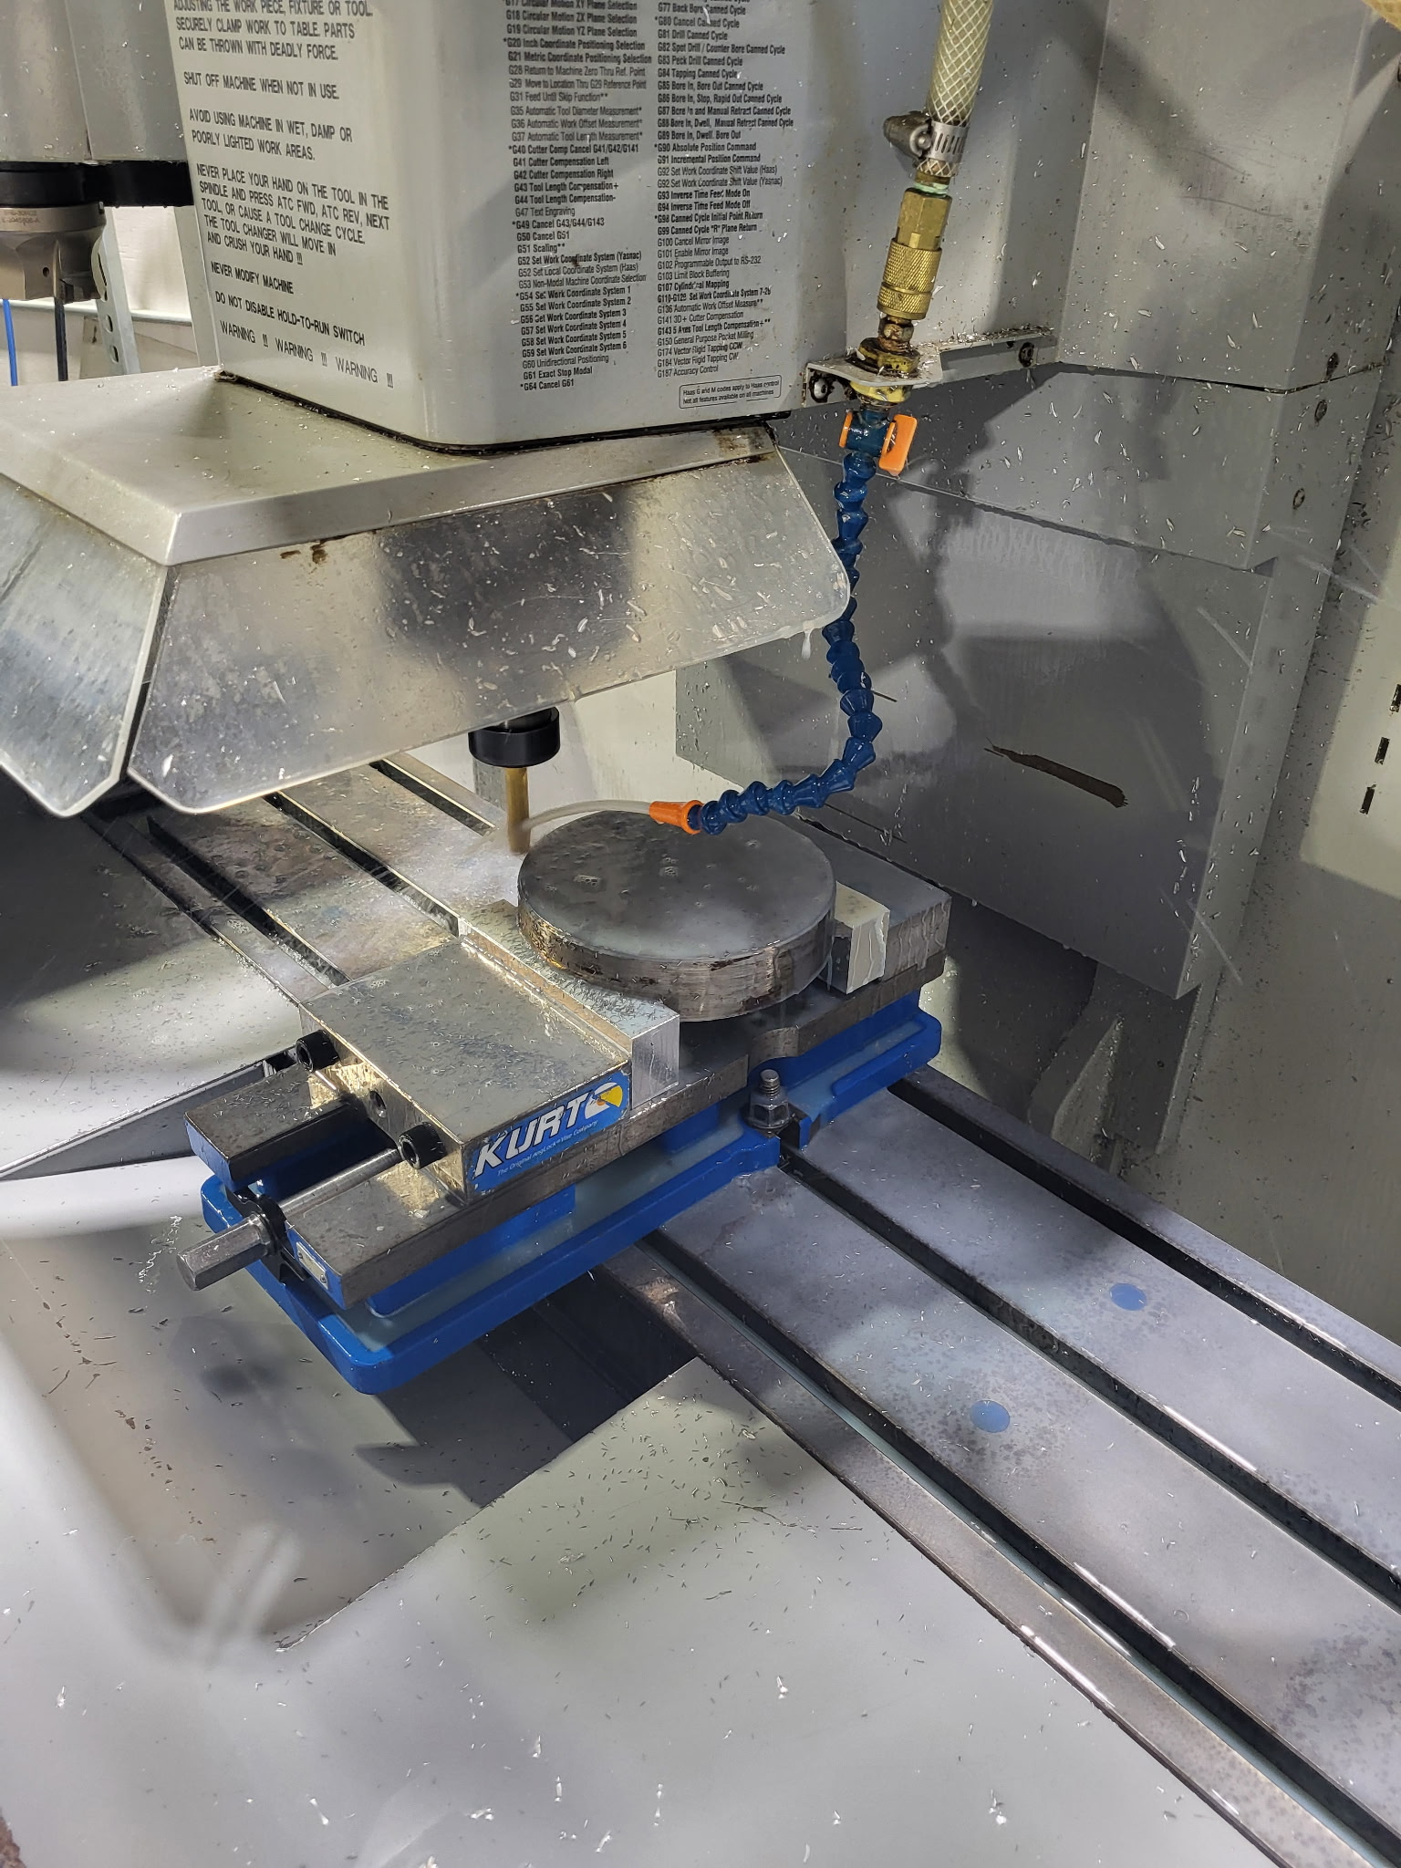
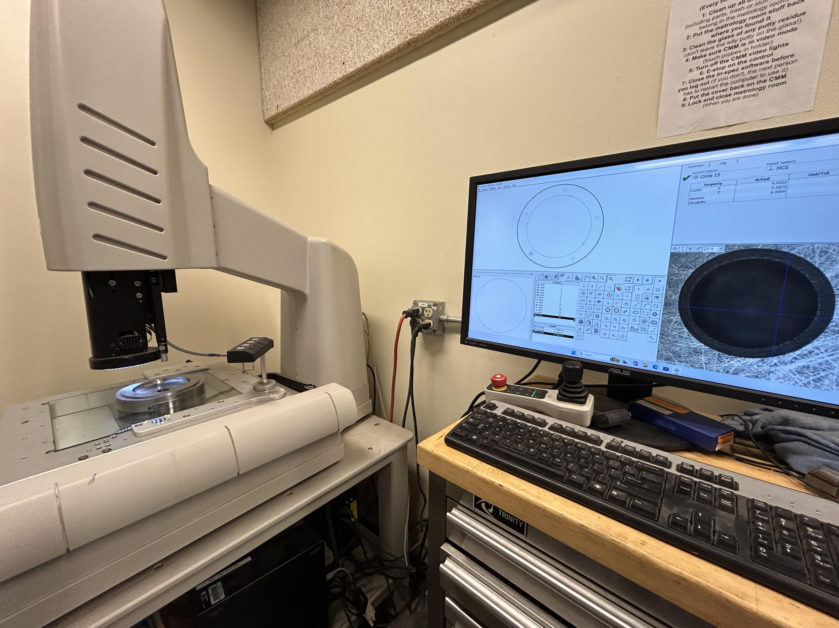
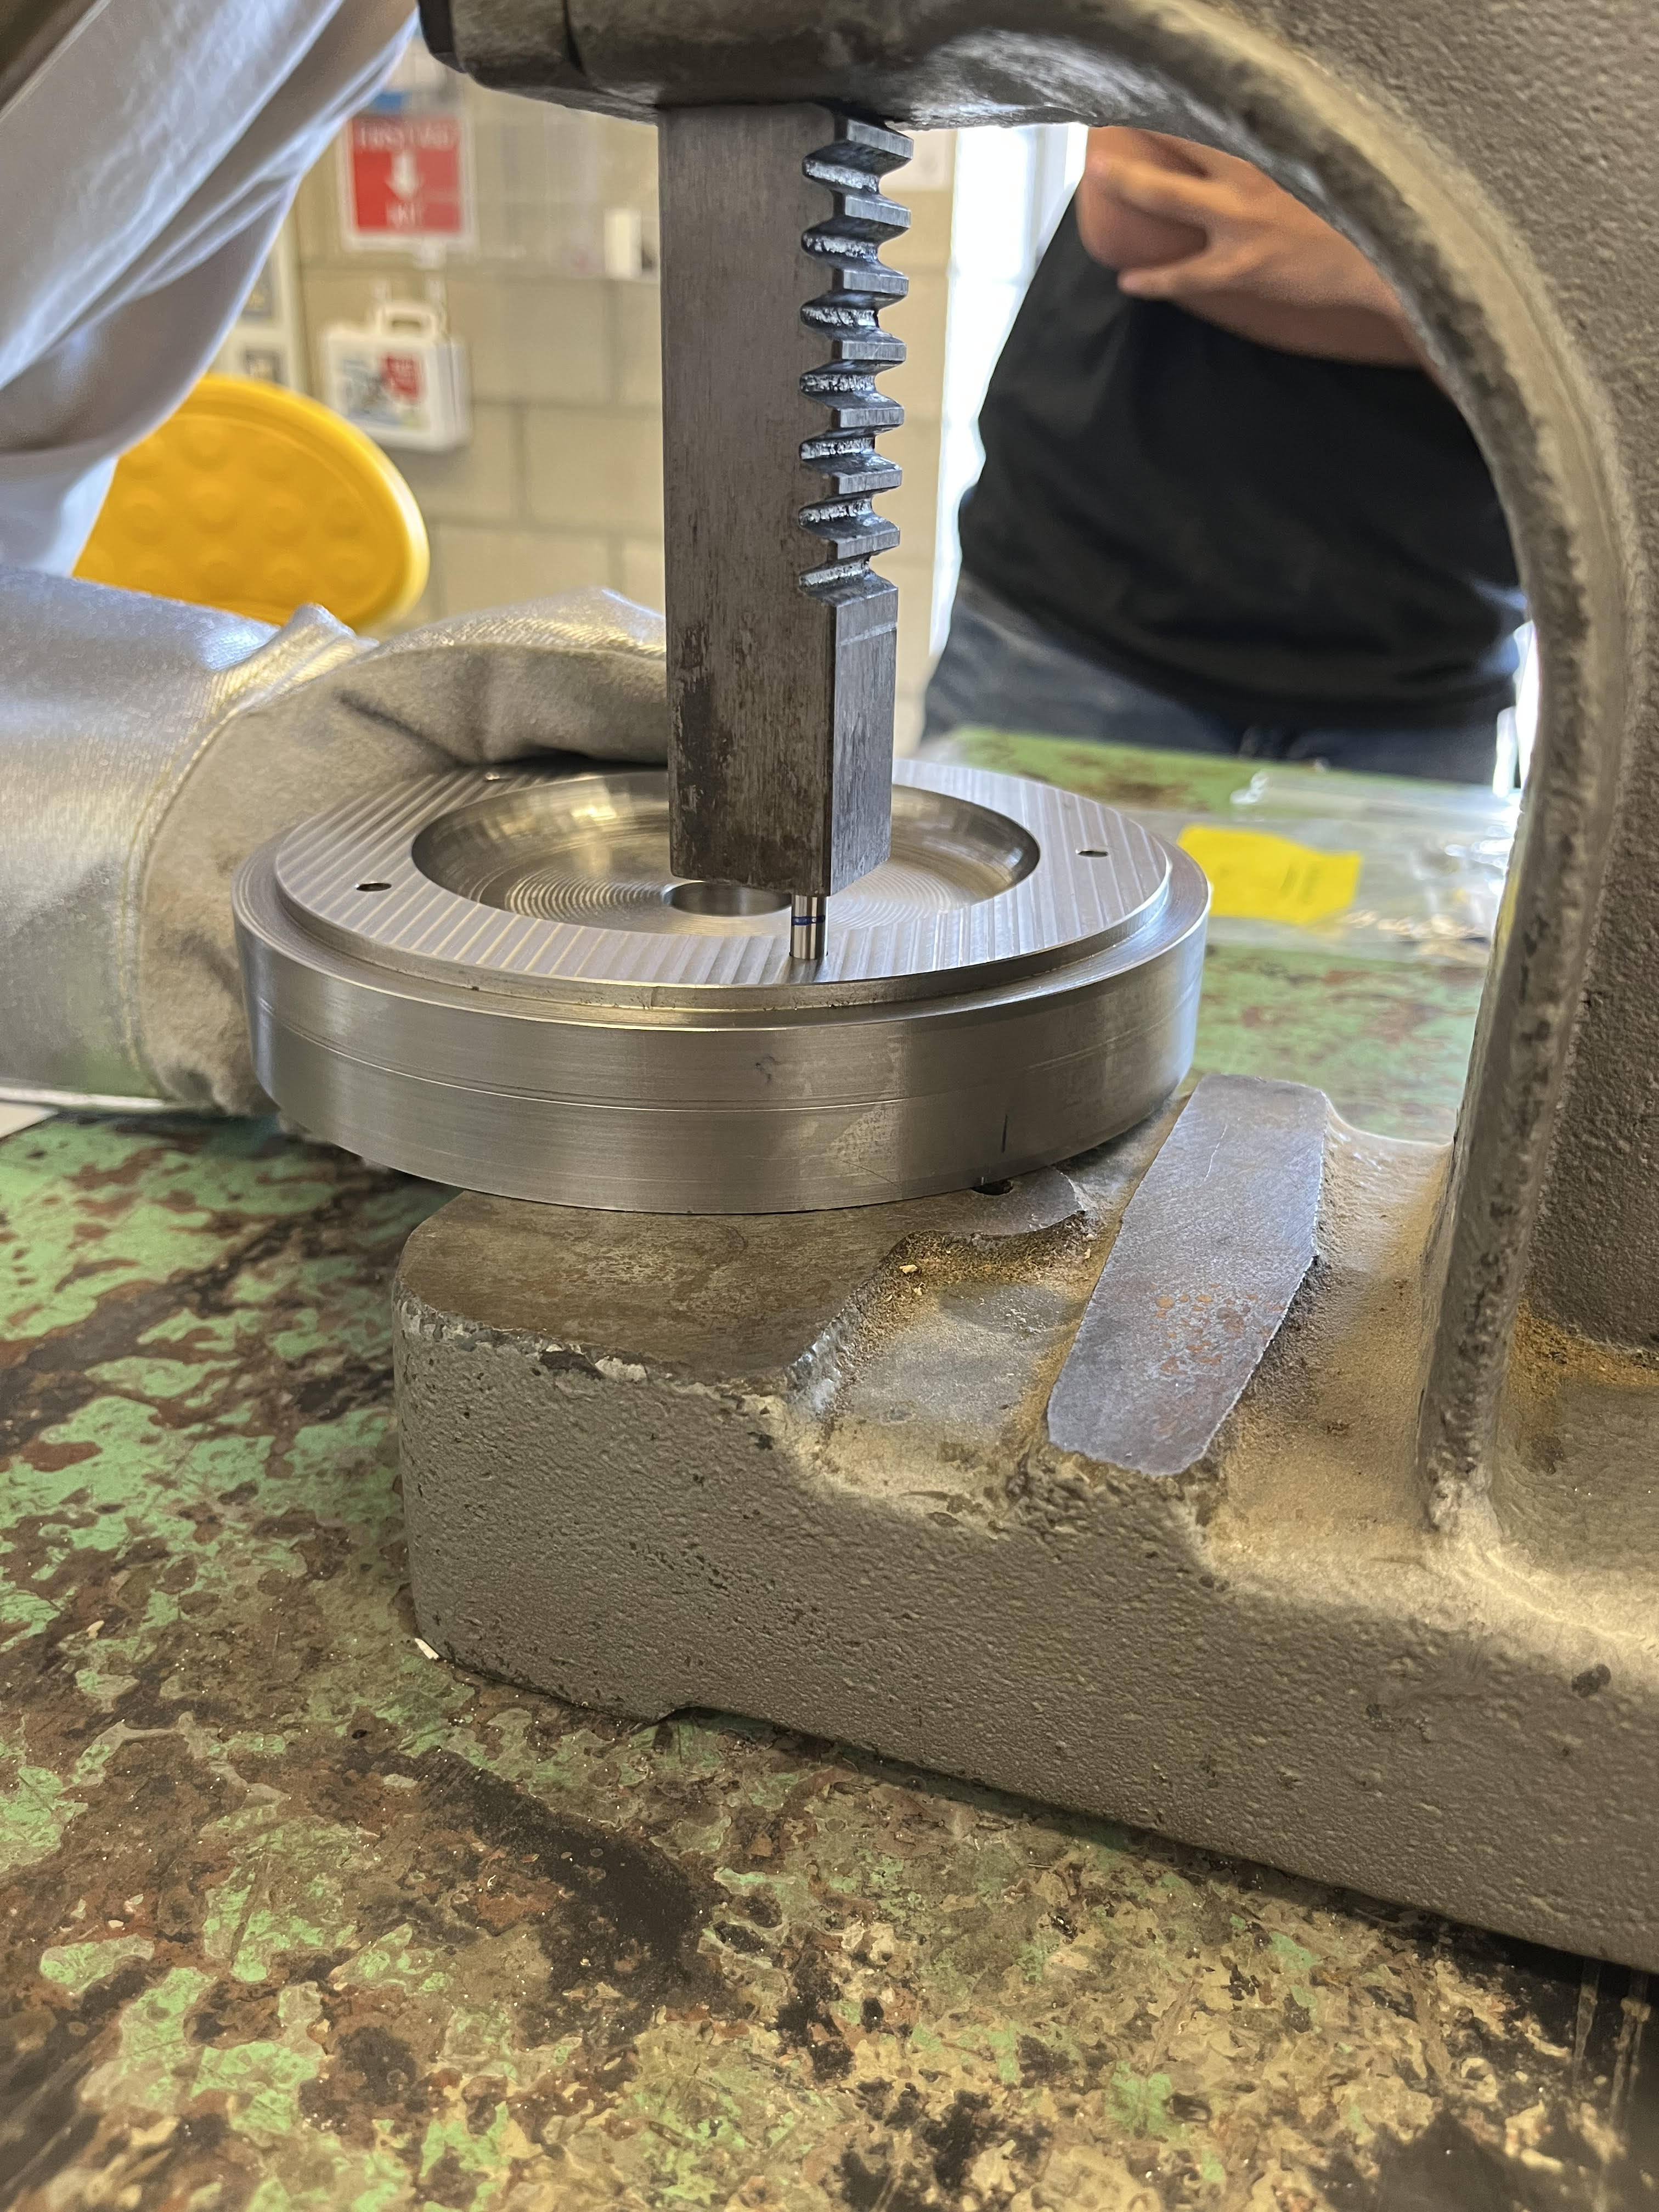
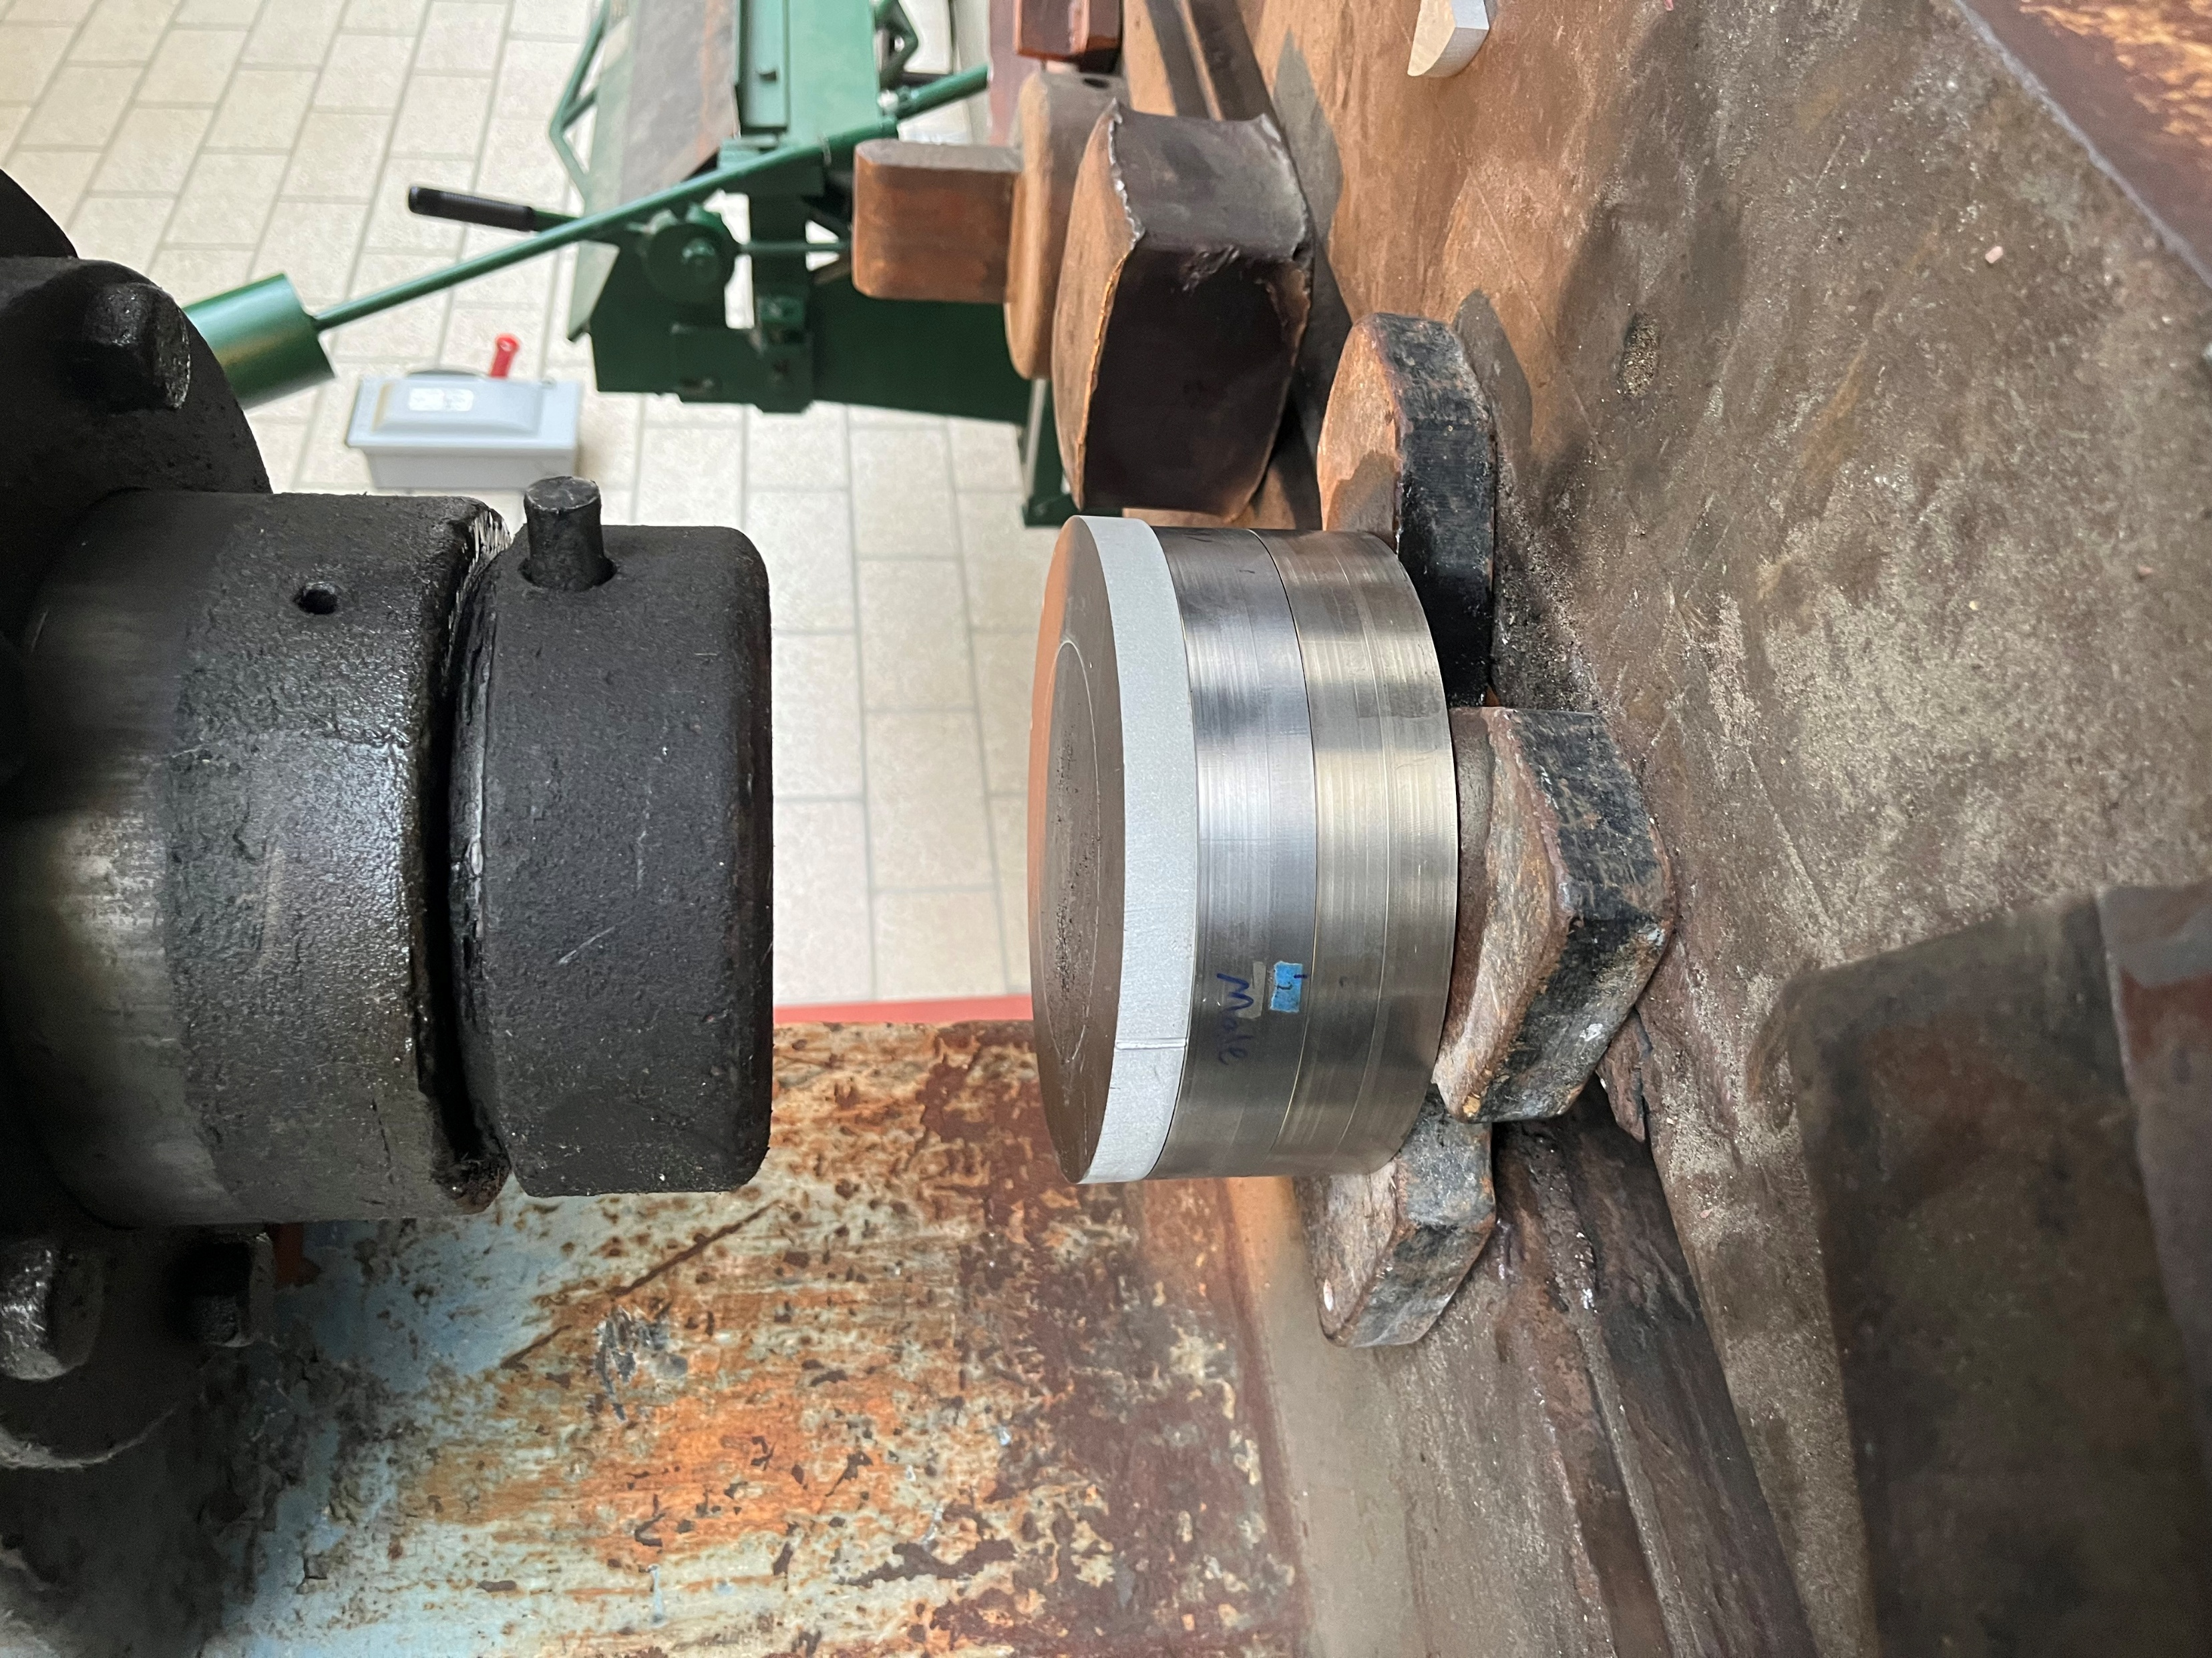
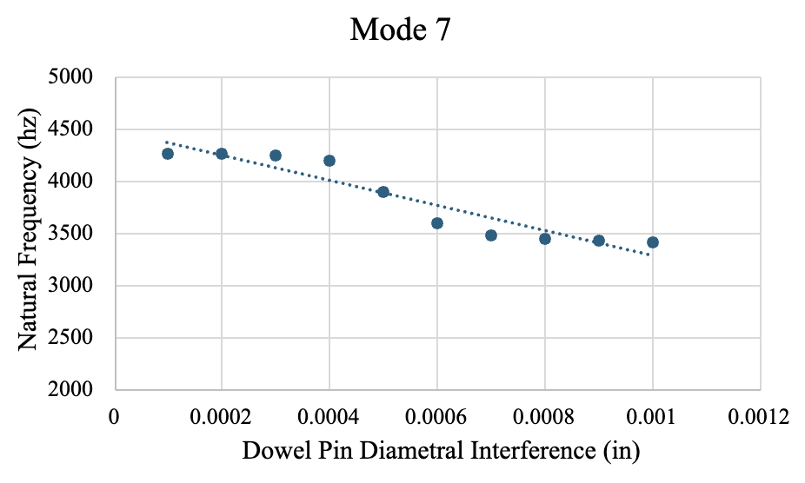
Compressor Rotor Joints and Fits Interference Study
Advisor: Rick Lasko
Aubrey Perez – Bela Jimenez – Isaiah Guerrero – Jireh Velasquez
Advisor: Manny Aldana
Background
Modeling & Testing
Results – Free-Free
Solar Turbines
ANSYS Model
Configuration 1
Configuration 2
Welded Configuration
Solar Turbines uses stacked rotor plates in their compressors
Plates are joined using interference pilot fits and dowel pins
The plates have experienced radial shifting after compressor operation
Stiffness changes are predicted to affect natural frequency response and radial shifting
A model of two plates with all necessary connections was created in ANSYS for each configuration. Each model was then put through a modal analysis to theoretically determine the first 3 mode shapes. Having these 3 natural frequencies allowed us to draw conclusions on design decisions.
Frequency (kHz)
Frequency (kHz)
Frequency (kHz)
The Problem
Second Natural Frequency Comparison | Configuration 1 | Configuration 2 | Welded Configuration
ANSYS | 4.397 kHz | 4.826 kHz | 5.892 kHz
Experimental | 4.384 kHz | 4.608 kHz | 4.88 kHz
Percent Difference | 0.29% | 4.62% | 18.78%
Rotor plates shifting radially under operating loads potentially affect compressor stability and vibration behavior.
Ansys model of a plate configuration
Physical Testing
Third Natural Frequency Comparison | Configuration 1 | Configuration 2 | Welded Configuration
ANSYS | 5.655 kHz | 5.765 kHz | 7.592 kHz
Experimental | 5.392 kHz | 5.935 kHz | 8.033 kHz
Percent Difference | 4.76% | 3.06% | 5.64%
The ANSYS simulation for mode shapes was validated and refined through modal impact hammer testing. The three plate configurations were put through two testing conditions:
Free-Fixed Condition
Free-Free Condition
A spectrum analyzer was used to read the natural frequencies from the impact hammer and accelerometer, allowing for a direct comparison with the ANSYS model. Three types of tests were conducted for each condition:
Stationary Accelerometer/Hammer
Roving Hammer/Fixed Accelerometer
Roving Accelerometer/Fixed Hammer
Free-fixed testing condition
*Side schematic of rotor plates’ connection with pilot fits and dowel pins
Objective
Investigate how interference-fit joints affect compressor assembly stiffness with three configurations:
Fully welded configuration
Low interference configuration (0.001in – 0.002in) with short pilot ledge overlap
High interference configuration (0.002in – 0.004in) with long pilot ledge overlap
Perform modal analysis in ANSYS to predict effects on stiffness from varying interference fits and pilot ledge lengths
Manufacture and test a welded configuration and two interference configurations to validate ANSYS simulation
d
Second Mode Shape
Third Mode Shape
Free-free testing condition
Conclusion
ANSYS Iterations
Increasing pilot ledge length was the main contributor to the increase in natural frequency and overall assembly stiffness
Configuration 2 consistently produced higher frequencies than Configuration 1 in both ANSYS and experimental testing.
The welded configuration produced the highest stiffness and natural frequencies overall.
ANSYS predictions closely matched experimental trends, validating the simulation approach.
Differences between simulation and testing were likely caused by manufacturing tolerances, material variation, and testing inconsistencies.
Manufacturing
First natural frequency:
Increasing dowel pin interference fit and pilot interference fits did not have a big impact on increasing the natural frequency and stiffness of the assembly
Increasing the pilot ledge length did significantly increase stiffness
Machining plates on CNC mill
CMM to measure critical dimensions
Pressing in dowel pins with arbor press
Pressing both plates with hydraulic press

